Slide 1

G2M Investment Project
Virtual Internship
20/05/2022

Slide 2
G2M(cab industry) Case study
Problem Description:
XYZ is a private firm in US. Due to remarkable growth in the Cab Industry in last few years and multiple key players in the market, it is planning for an investment in Cab industry and as per their Go-to-Market(G2M) strategy they want to understand the market before taking final decision.
Objective:
To give actionable insights to help them identify the right company to make their investment.

Slide 3
Data Exploration
Steps of Analysis:
1.Understanding the Data
2.Data Cleaning
3.Analyzing the Data
4.Interpreting the Results
Assumptions:
In our Analysis of the given datasets we are assuming
• “Cost of Trip” in Cab_Data.csv as expenses incurred by the company for that particular ride.
• “Price Charged”in Cab_Data.csv as Price which the customer/user will be paying to the
company.
• “Users” in City.csv as number of cab users in that city.
• Outliers in “Profit” and “Price per KM” columns in master dataset are due to availing of
premium services and use of luxury cars by the customers.

Slide 4
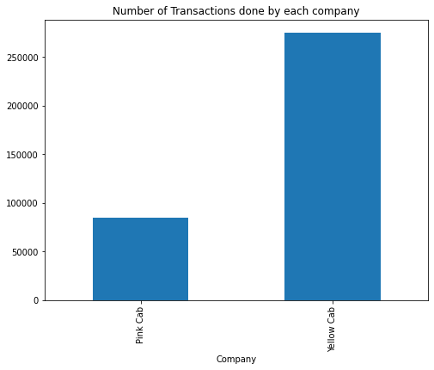
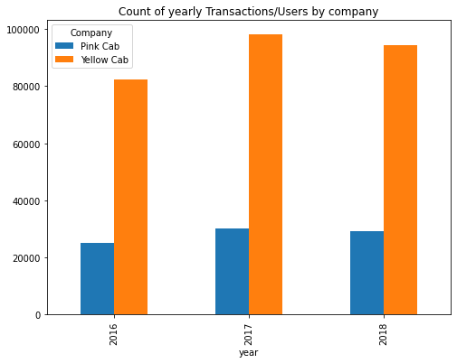
Analysis of Transactions by Company
Number of Total transactions and yearly transactions of Yellow cab company is more than the Pink Cab
Company.

Slide 5
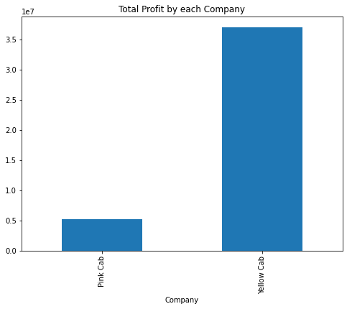
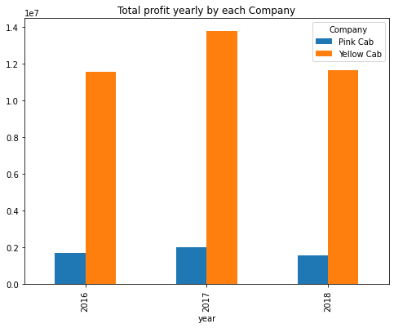
Profit Analysis by Company
Above plots shows that the Total profit and yearly Profit of Yellow cab Company is more than Pink Cab
Company.

Slide 6
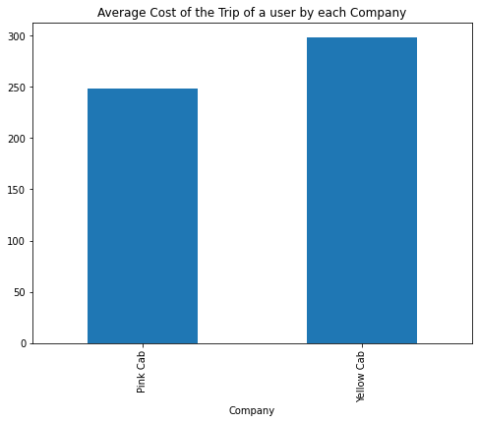
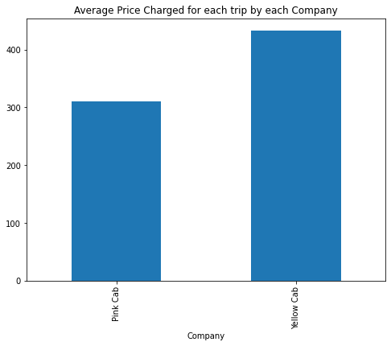
Profit Analysis by each Transaction
From Above graphs we can say there is an average Profit Margin of 100 dollars from each user in
yellow cab company and 50 dollars in Pink cab company. So Yellow cab company has more Profit
Margin than Pink cab Company

Slide 7
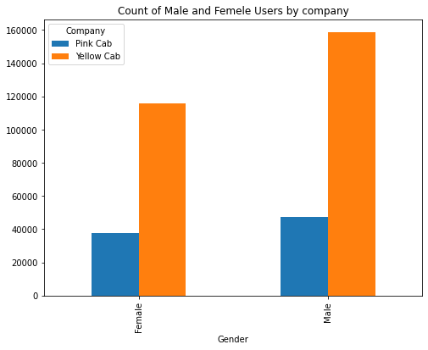
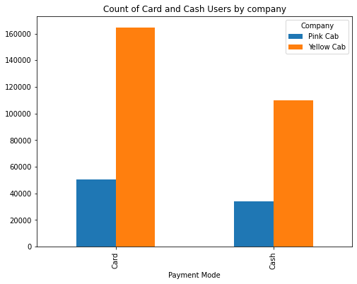
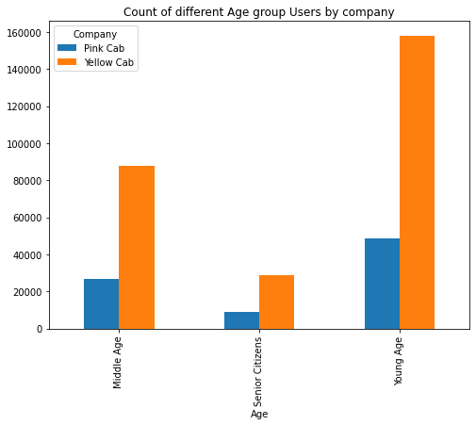
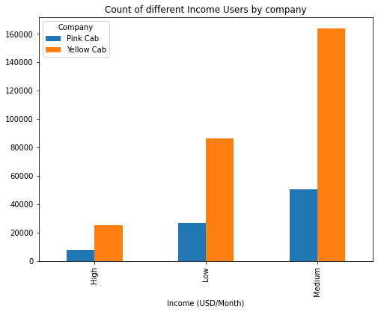
Analysis of different categories by company

Slide 8
Continued..
By looking at all above plots we can say there is same Proportionality in both the companies in all the
categories of users and Yellow cab is doing better than Pink cab company in all categories of users.

Slide 9
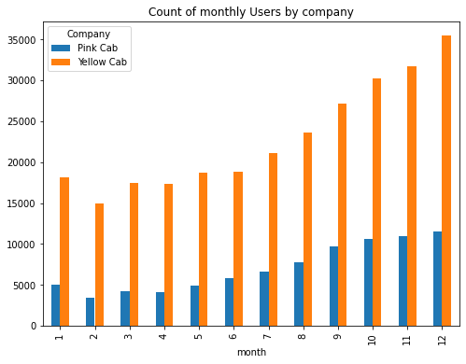
Seasonality in the cab users by Company
By above plot we can say that there is a seasonality in number of cab users in both the companies indicating
more usage of cabs in end of the year due to Christmas and New year holidays and celebrations and low usage
in the beginning of the year due to winter season.

Slide 10
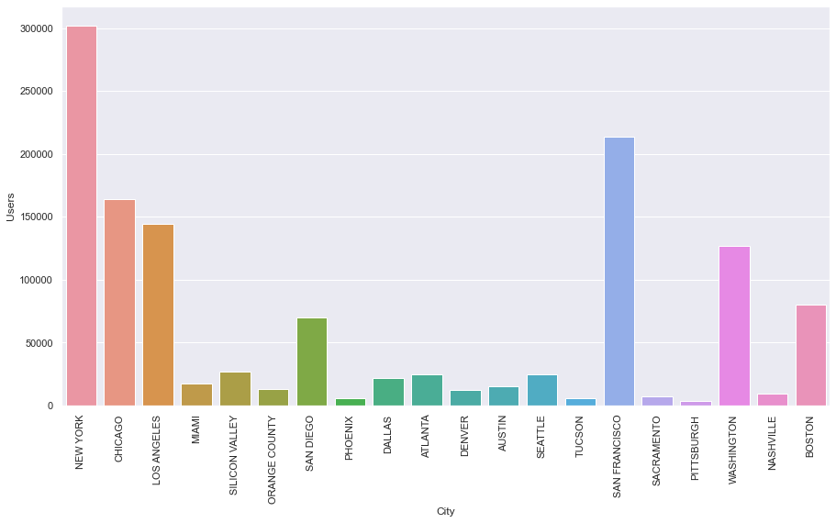
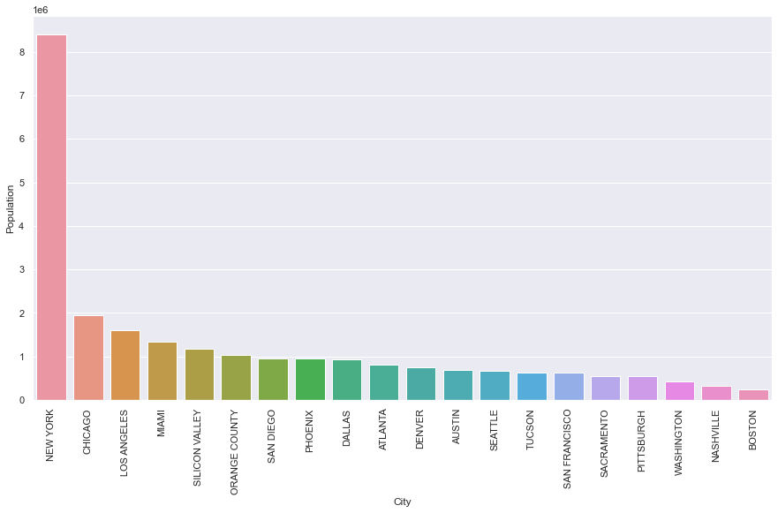
Analysis of Users and Population by City

Slide 11
Continued..
From the above plots we can see Newyork,Washington,Sanfransisco,Chicago and Los-angels are having more
cab users and population wise also Newyork,Chicago and Los-angels are in the top.
Lets Analyze the Users by company among the cities in next slide.

Slide 12
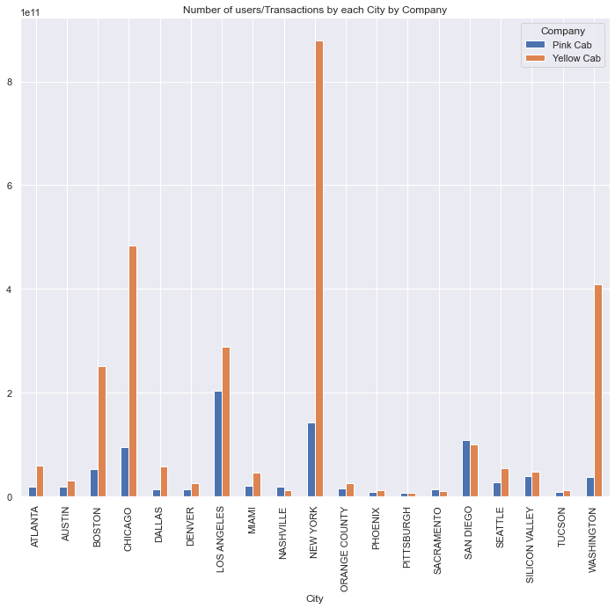
Analysis of User Transactions by City by each Company
By above plot we can say that Yellow cab company is doing good business in top cities which has more cab users and which has more Population like Newyork,Chicago,Loasangels and Washington than Pink Cab company.

Slide 13
Recommendations
After analyzing the data given and evaluating both the companies in below points , we have found
Yellow Cab Company is better than Pink Cab Company.
Transactions/Number of Rides: Yellow cab company has done more number of rides than Pink cab company which shows there is more business happening for Yellow cab than Pink cab.
Profit:Total and Yearly Profit of Yellow cab company is more than the Pink Cab company.
Even Profit Margin per user is also more in Yellow cab company than the Pink cab company.
Customer Reach in different Categories: There is same Proportionality in both the companies in all the categories of users but Yellow cab is doing better than Pink cab company in all categories of users.
Seasonality: Though there is a seasonality in the business Yellow cab company is doing better throughout the year than Pink cab company.
Customer Reach in Cities: Yellow cab company is doing better in top cities where there is more population as well as more cab usage than Pink cab company.
Based on above all points we recommend Yellow Cab company to Invest.

Slide 14
Thank You

